Slide 1


Chapter 5
Array
Department of E-Commerce
Faculty of Science and Information Technology
Kolej Universiti Islam Antarabangsa Selangor (KUIS)
http://www.kuis.edu.my/fstm

Slide 2


A variable is a storage area holding a number or text. The problem is a variable hold only one value.
An array is a special variable, which can store multiple values in one single variable.

Slide 3

If you have a list of items (a list of student names, for e.g.), storing the student names in single variables could look like this:
$std1=“Anas”;
$std2=“Hajar”;
$std3=“Shah”;

Slide 4
However, what if you want to loop through the student names and find a specific one? And what if you had not 3 names, but 300?
The best solution here is to use an array!
An array can hold all your variable values under a single name. And you can access the values by referring to the array name.
Each element in the array has its own index so that it can be easily accessed.

Slide 5
In PHP, there are 3 kind of arrays:
  Numeric array - An array with a numeric index.
      Assign using AUTOMATIC method.
      Asign using MANUAL method.
  Associative array - An array where each ID key is associated with a value.
  Multidimensional array - An array containing one or more arrays.

Slide 6
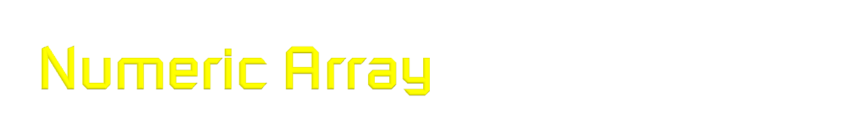
Assign using AUTOMATIC method (the index starts at 0).
$std(“Anas",“Hajar",“Shah",“Nurul");
Assign using MANUAL method.
  $std[0]=“Anas";
  $std[1]=“Hajar";
  $std[2]=“Shah";
  $std[3]=“Nurul";

Slide 7

<?php
$std[0]="Anas";
$std[1]="Hajar";
$std[2]="Shah";
$std[3]="Nurul";
echo $std[0] . " and " . $std[1] . " are the students of FSTM.";
?>

Slide 8

There are a lot of array functions. One of them is array_pop().
The array_pop()function deletes the last element of an array.
E.g.:
  <?php
  $faculty=array("FSTM","AI","FPM");
  $delete=array_pop($faculty);
  echo $delete;
  ?>

Slide 9

